Slide 1
Why do we study probability and statistics in the modern era?"
Decision Making in Uncertainty :
using chances and data to help choose the best option when we don't know what will happen for sure.
Data-Driven World
to analyze data, find patterns, make predictions, and help in making better decisions based on that information.
Scientific Research
validate hypotheses, and ensure that experimental results are reliable and significant.
Machine Learning & AI
to build models that learn from data, make predictions, and handle uncertainty in decision-making.

Slide 2
Why do we study probability and statistics in the modern era?"
Healthcare
to analyze patient data, assess treatment effectiveness, predict disease outbreaks, and guide public health decisions.
Policy Making
predict the outcomes of different policies, and make informed decisions to address social, economic, and public health issues.
Sports & Gaming
o analyze player performance, predict outcomes, set betting odds, and optimize strategies for both teams and individuals.

Slide 3
DEFINATION
Statistics is the science of collecting, analyzing, interpreting, presenting, and organizing data. It helps in understanding patterns, trends, and making decisions based on data.
probability deals with predicting future events.
statistics involves analyzing past data.

Slide 4
Data
collection of facts, figures, observations, or values that can be processed and analyzed to gain insights, inform decisions, and draw conclusions
Data is a collection of information, numbers, or observations that can be looked at and analyzed to help us understand things, make decisions, and reach conclusions.

Slide 5
Types of Data in Statistics:
Quantitative Data:
Data that can be measured and expressed numerically (e.g., height, weight, age, income).
Qualitative Data:
Data that describe characteristics or categories and cannot be measured numerically (e.g., gender, color, type of product).

Slide 6
Case Study: Customer Satisfaction at a Restaurant
1. Quantitative Data Example
The restaurant wants to evaluate customer satisfaction based on measurable factors.
They collect quantitative data through a customer feedback survey that includes questions like:
How many times per month do you visit the restaurant?
Rate your dining experience on a scale of 1 to 10.
How long did you wait for your food (in minutes)?
How much did you spend on your meal?

Slide 7
2. Qualitative Data Example
:
The restaurant also wants to understand customer opinions about their overall dining experience.
They collect qualitative data by asking open-ended questions such as:
What did you like most about your visit?
Is there anything you would like us to improve?
How would you describe the atmosphere of the restaurant?

Slide 8
Quantitative Data: Types
Discrete Data: Data that can take specific values (e.g., number of students in a class).
Continuous Data: Data that can take any value within a range (e.g., height, weight, temperature).

Slide 9
Qualitative Data (Categorical Data):
4. Based on Measurement Scale
1)Nominal Scale:
Definition: Used for labeling variables without a quantitative value (e.g., gender, nationality).
2) Ordinal Scale:
Definition: Used for variables with a defined order but no fixed distance (e.g., education level).

Slide 10
Interval Scale:
Definition: Numeric data with meaningful intervals but no true zero (e.g., temperature in Celsius).
Ratio Scale:Definition: Numeric data with meaningful intervals and a true zero (e.g., weight, height)

Slide 11
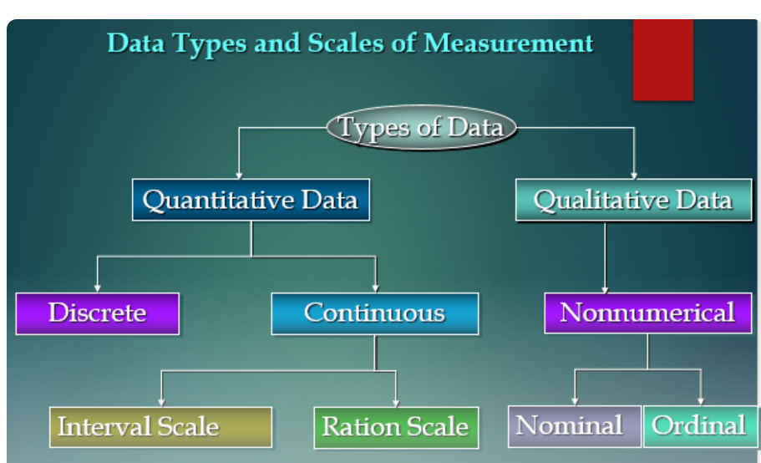

Slide 12
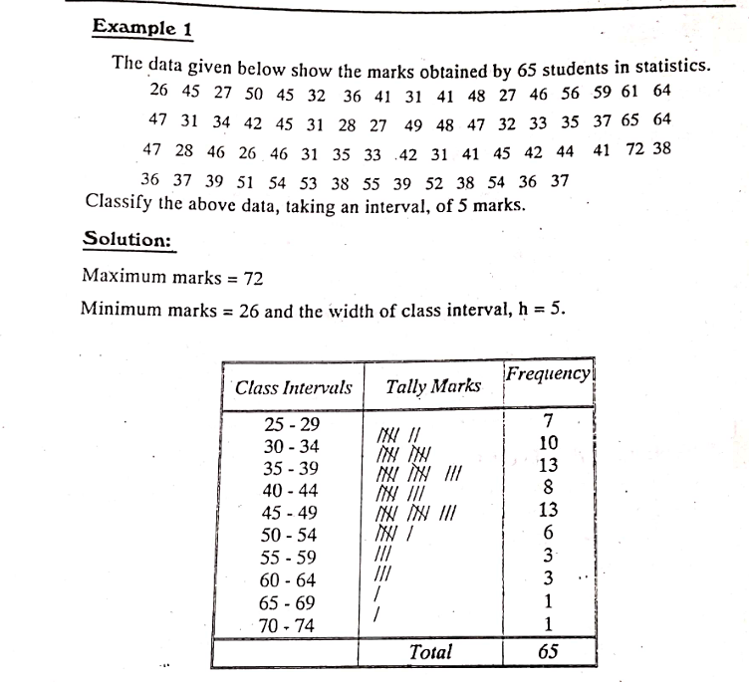

Slide 13
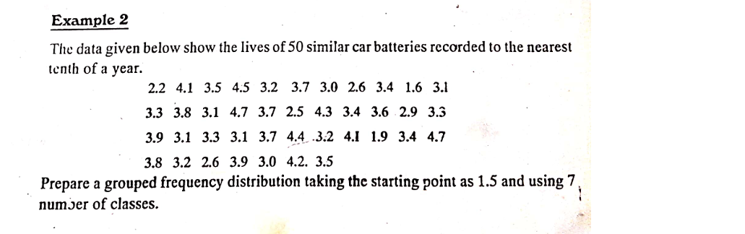
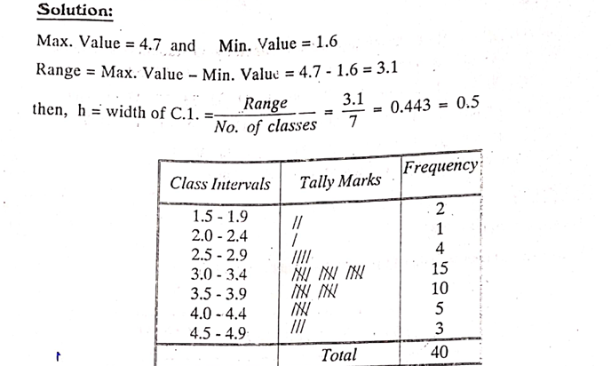

Slide 14
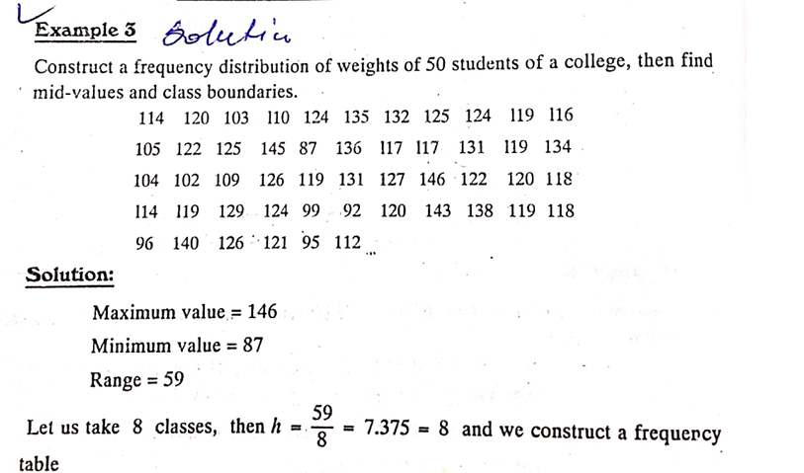

Slide 15
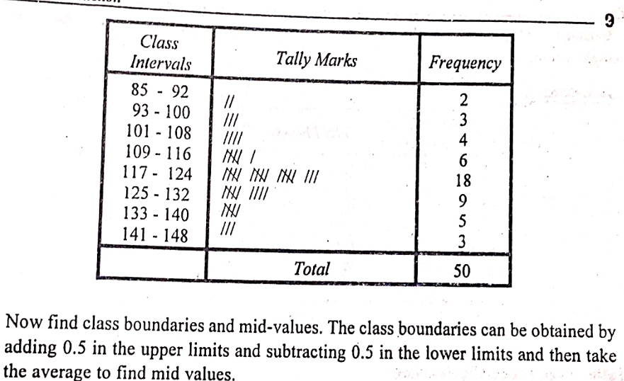

Slide 16
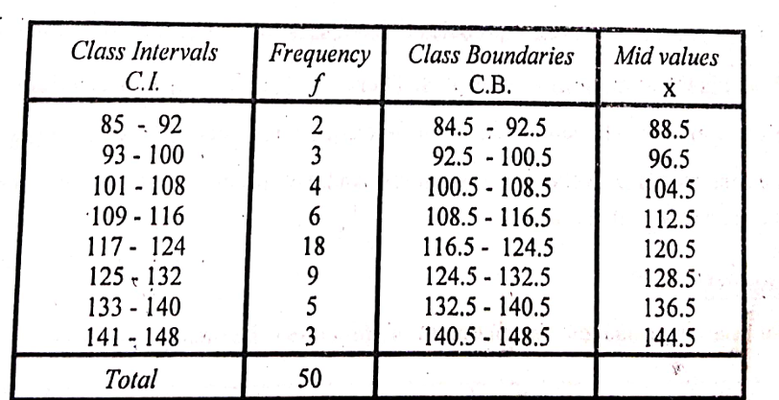

Slide 17
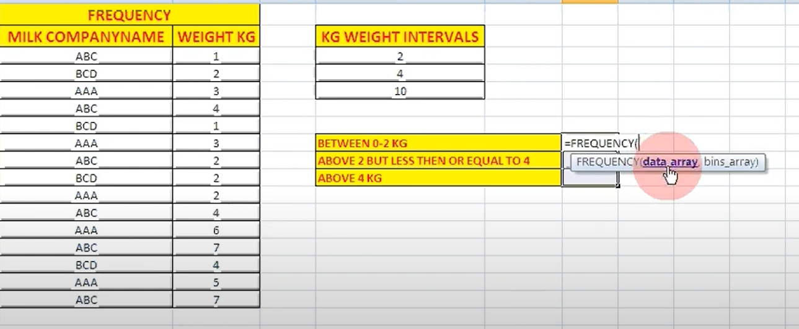
First practical

Slide 18
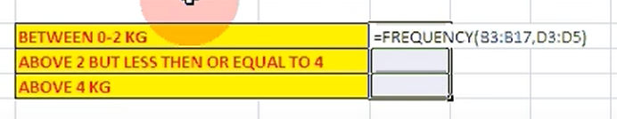
Ctr shift enter

Slide 19
